Slide 1
Finite State Machines
Case Study
LCD Display
©Paul Davies. Not to be copied, used, or revised without explicit written permission from the copyright owner.
1
Notes:
1

Slide 2
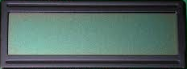
State Machine Case Study – Driving DE2 LCD Display
The DE2 board has an LCD display present with the following signals
An 8 bit data bus DB0-DB7 (used to write Commands or ASCII chars)
An RS signal to indicate if the data on the data bus is a command to the LCD display e.g. erase screen, or an ASCII character to display (1 = Data, 0 = LCD Command)
A R/W signal to read or write data to the display (1 = read, 0 = write)
An E signal to enable the display (1 = enabled, 0 = disabled).
The data sheet for the LCD display is on the web site and describes the protocol of signaling required to drive it as well as the commands that it recognises.
DE2 LCD display
DB0-DB7
E
RS
R/W

Slide 3
LCD Timing Diagram/Protocol
The timing diagram of a write data operation is given below, where RS = 1 (writing a command is the same except RS = 0). All times are minimums – i.e. must be “at least”, but can be longer. A write operation starts when E goes high and ends when E goes low.
Problem: Design a state machine to drive these signals to display 1 character.
RS and R/W setup time relative to start of E pulse
Minimum width of E pulse
RS, R/W and Data Hold time relative to end of E pulse
RS
40nS
10nS
R/W
230nS
E
10nS
80nS
DB0-7
ASCII CODE
Data Set up time relative to end of E pulse
Data Hold time relative to end of E pulse

Slide 4
State Machine Case Study – DE2 LCD Display
Solution
Break down the timing diagram into a number of states. This way, we can create a state machine to cycle through these states and then output the signals we want as a function of each state.
A state machine clock of 25Mhz means state transitions can occur every 40ns.
Adjust our generated LCD timings so as to align to multiples of 40ns without violating minimum timing (see below).
This means E pulse width stretched from 230ns to 240ns and Data Bus, RS and RW hold times extended to 40ns.
RS
40nS
R/W
40nS
40nS
240nS
40nS
E
80nS
DB0-7
ASCII CODE

Slide 5
State Machine Case Study – DE2 LCD Display
This timing diagram can now be designed around a State Machine comprising of 9 states, which cycle from state S0 (the ready state) to state S8 before returning to S0.
A Ready signal has been included as an output from the state machine to indicate when it is ready to accept commands (logic 1 = ready, 0 = busy).
The value of the signals in each state represent the outputs while in that state, e.g. in state S0: RS = 0, R/W = 1, E = 0, Ready = 1, DB0-7 is not yet defined since we are in the idle state and not writing a character yet etc.
S0
S1
S2
S3
S4
S5
S6
S7
S8
S0
40nS
40nS
40nS
40nS
40nS
40nS
40nS
40nS
40nS
40nS
RS
0
1
1
1
1
1
1
1
0
0
R/W
1
0
0
0
0
0
0
0
0
1
E
0
0
1
1
1
1
1
1
0
0
DB0-7
ASCII CODE
Ready
1
0
0
0
0
0
0
0
0
1

Slide 6
State Machine Case Study – DE2 LCD Display
Our State Machine interface to the Outside World and to the LCD display will look like this. The ASCII data for the character we are going to write will come from the slider switches on the DE2 (set these to the ASCII value of the character being displaced) before pressing the start button and change them after releasing it.
If PB2 is pressed (logic 0), then it is assumed the data on DB0-DB7 is an LCD command, otherwise it is an ASCII character intended for display.
SW0-SW7
State Machine
ASCII Data or Command
LCD Display
Set to value of ASCII Character
DataIn
DataOut
DB0-DB7
PB 2
DataOrCommand
RS
R/W
PB 1
Start
E
PB 0
Reset
Ready
Red LED 0
Clock
Ready Status
25MHz Oscillator

Slide 7
State Machine Case Study – DE2 LCD Display
All we need to do now is add a Start signal to the timing diagram that triggers the state machine to cycle through the states shown below when it detects ‘Start = 0’.
Because we do not know how long the start signal will be present for (it depends on how long you hold your finger down on PB1), we shall start the state machine when Start = 0 and remain in state S8 until Start returns to logic 1 (i.e. the start button is released).
This ensures that the operation is only performed once, for each press of the start button, i.e. you have to press and release the button.
S0
S1
S2
S3
S4
S5
S6
S7
S8
S8
S0
40nS
40nS
40nS
40nS
40nS
40nS
40nS
40nS
40nS
40nS
40nS
RS
RS set byPB2 (depends on you with your finger !!)
R/W
E
DB0-7
Command or ASCII CODE present on slider switches (depends on you !!)
Ready
Only return to state S0 when START is released
START

Slide 8
State Machine Case Study – DE2 LCD Display
The State Transition Diagram
This is actually quite easy as it is mostly just a sequence of states that starts in state S0 and is triggered when input Start = 0. It then moves through states S0-S8. It then waits in State S8 for Start to return to 1 (i.e. blue push button released) before returning to state S0 again.
Start = 1
S0
Start = 0
S1
S2
S3
S4
Reset
Start = 1
S8
S7
S6
S5
Start = 0

Slide 9
State Machine Case Study – DE2 LCD Display
The Current State – Next State Table
Current State |  |  |  | Input | Next State
Q[3-0] |  |  |  | Start | D[3-0]
0 | 0 | 0 | 0 | 1 | 0 | 0 | 0 | 0
0 | 0 | 0 | 0 | 0 | 0 | 0 | 0 | 1
0 | 0 | 0 | 1 | X | 0 | 0 | 1 | 0
0 | 0 | 1 | 0 | X | 0 | 0 | 1 | 1
0 | 0 | 1 | 1 | X | 0 | 1 | 0 | 0
0 | 1 | 0 | 0 | X | 0 | 1 | 0 | 1
0 | 1 | 0 | 1 | X | 0 | 1 | 1 | 0
0 | 1 | 1 | 0 | X | 0 | 1 | 1 | 1
1 | 0 | 0 | 0 | 0 | 1 | 0 | 0 | 0
1 | 0 | 0 | 0 | 1 | 0 | 0 | 0 | 0
Start = 1
S0
Start = 0
S1
S2
S3
S4
Reset
Start = 1
S8
S7
S6
S5
Start = 1

Slide 10
State Machine Case Study – DE2 LCD Display
------------------------------------------------------------------------------------------------------------------------------------------------ -
-- Combinatorial Logic to define the signals that drive the next state based only on the current state and Start
------------------------------------------------------------------------------------------------------------------------------------------------
Process( Current_state , Start)
BEGIN
Next_State <= S0 ; -- default next state value, override as necessary
if( current_state = S0) then -- if we are in the idle state (doing nothing)
if(Start = '0') then -- if we get the start signal to begin writing to the LCD display
Next_State <= S1 ; -- Signal to state register that our next state should be S1 otherwise stay in S0
end if ;
elsif ( current_state = S1) then Next_State <= S2 ;
elsif ( current_state = S2) then Next_State <= S3 ;
elsif ( current_state = S3) then Next_State <= S4 ;
elsif ( current_state = S4) then Next_State <= S5 ;
elsif ( current_state = S5) then Next_State <= S6 ;
elsif ( current_state = S6) then Next_State <= S7 ;
elsif ( current_state = S7) then Next_State <= S8 ;
elsif ( current_state = S8) then
if(Start = '0') then -- if start still pressed, stay in this state
Next_State <= S8 ; -- otherwise go to S0
end if ;
end if ;
end process ;

Slide 11
State Machine Case Study – DE2 LCD Display
The Output Table based on Current State
From the waveform below we see the following output table(s).
State | RS | R/W | E | Ready
S0 | pb2 | 1 | 0 | 1
S1 | pb2 | 0 | 0 | 0
S2 | pb2 | 0 | 1 | 0
State | RS | R/W | E | Ready
S3 | pb2 | 0 | 1 | 0
S4 | pb2 | 0 | 1 | 0
S5 | pb2 | 0 | 1 | 0
State | RS | R/W | E | Ready
S6 | pb2 | 0 | 1 | 0
S7 | pb2 | 0 | 1 | 0
S8 | pb2 | 0 | 0 | 0
S0
S1
S2
S3
S4
S5
S6
S7
S8
S8
S0
40nS
40nS
40nS
40nS
40nS
40nS
40nS
40nS
40nS
40nS
40nS
RS
RS set to PB2 (depends on you with your finger !!)
R/W
E
DB0-7
Command or ASCII CODE present on slider switches (depends on you !!)
Ready
START

Slide 12
State Machine Case Study – DE2 LCD Display
------------------------------------------------------------------------------------------------------------------------------------------------------------
Combinatorial Logic to define the signals that drive the outputs to the LCD display based only on the current state
-------------------------------------------------------------------------------------------------------------------------------------------------------------
Process(Current_state, DataOrCommand, DataIn )
BEGIN
RS <= DataOrCommand ;
DataOut <= DataIn ;
if ( Current_state = S0 ) then
E <= '0' ; RW <= '1'; Ready <= '1' ;
elsif ( Current_state = S1 ) then
E <= '0' ; RW <= '0' ; Ready <= '0' ;
elsif ( Current_state = S2 ) then
E <= '1' ; RW <= '0' ; Ready <= '0' ;
elsif ( Current_state = S3 ) then
E <= '1' ; RW <= '0' ; Ready <= '0' ;
elsif ( Current_state = S4 ) then
E <= '1' ; RW <= '0' ; Ready <= '0' ;
elsif ( Current_state = S5 ) then
E <= '1' ; RW <= '0' ; Ready <= '0' ;
elsif ( Current_state = S6 ) then
E <= '1' ; RW <= '0' ; Ready <= '0' ;
elsif ( Current_state = S7 ) then
E <= '1' ; RW <= '0' ; Ready <= '0' ;
else -- state S8
E <= '0' ; RW <= '1' ; Ready <= '0' ;
end if ;
END Process ;

Slide 13
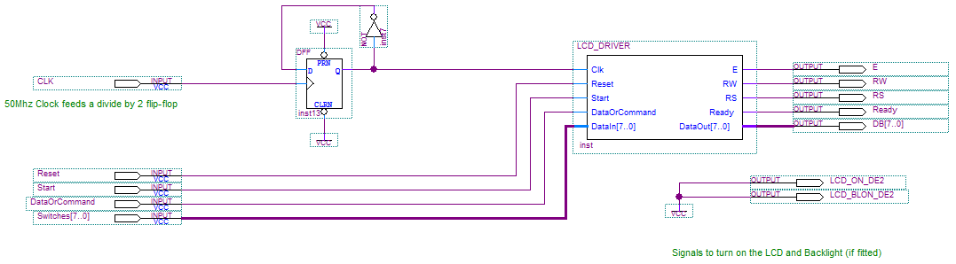
State Machine Case Study – DE2 LCD Display
Here is the circuit (the Quartus Project is on the web site)

Slide 14
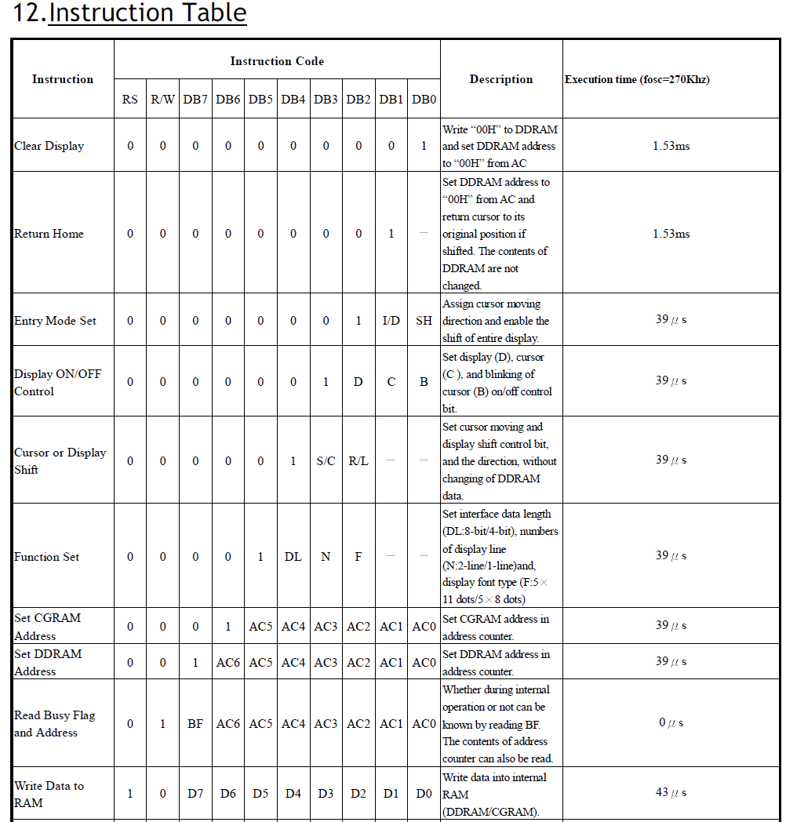
State Machine Case Study – DE2 LCD Display
Initialising the display
After power on, the LCD will need to be programmed by sending it some commands. See opposite.
The 8 bit hex codes for these commands are show below.
Set these up on the switches, hold down the PB2 button to indicate an LCD command and then press PB1 to start
Hex 38 – Set LCD to use an 8 bit interface, 2 line display, 5x7 character font
Hex 0C - Turn Display On, Turn Cursor Off, Turn Cursor Blinking Off
Hex 01 – Clear display

Slide 15
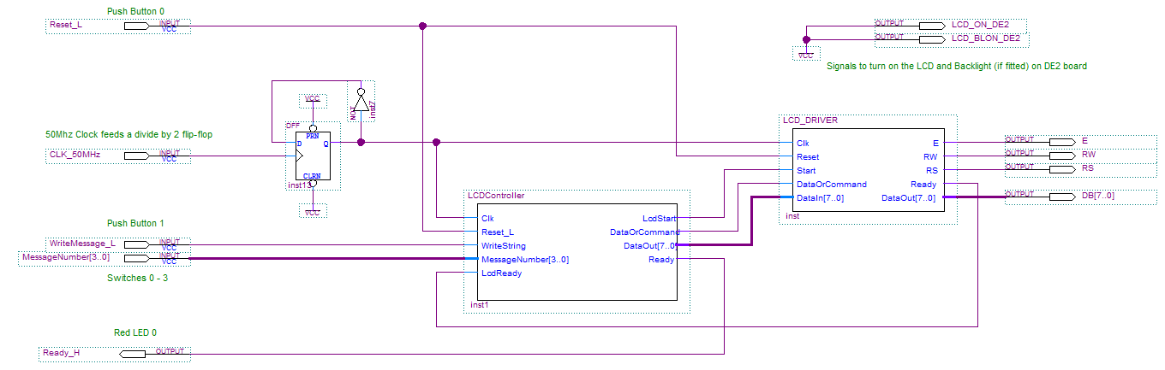
State Machine Case Study – DE2 LCD Display
Now we could design another state machine which presents characters to the state machine above (1 character at a time to display a string).
The LCD display will also need to be initialized by sending it various commands to set it for 2 row operation etc.
This particular example uses 4 of the slider switches to select from 1 of 16 messages to write to the LCD display.
The project is on Connect and is given as part of your assignment.
Ready output of lcd_driver is fed back to be an input to the LCD controller
4 switches select 1 of 16 messages

Slide 16
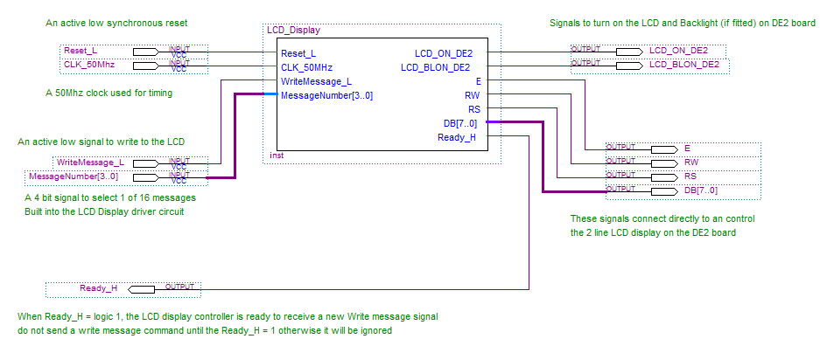
State Machine Case Study – DE2 LCD Display
Here’s the top level entity and symbol/pin assignment for the circuit on the previous slide

Slide 17
End of Chapter

